Slide 1
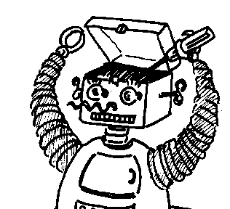
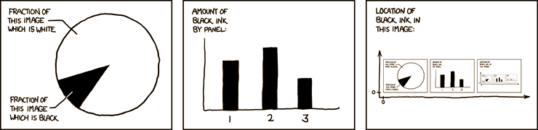

Maryland Metacognition Seminar
http://xkcd.com/
Building a Case for Relational Reasoning Strategies as "Meta"-Tools in Human Learning and Performance
Patricia Alexander
Department of Human Development, University of Maryland
19 November 2012, 12:00 PM
A. V. Williams Bldg., RM. 3258, College Park
Abstract:
Since the late 1970s, there has been growing evidence that far too many individuals are not particularly “meta” in their cognitive processing. Erroneous information goes undetected, judgments of learning are poorly calibrated to actual performance, and opportunities to bring pertinent knowledge and skills to bear during problem solving are frequently missed. Nonetheless, metacognitive awareness, knowledge, and strategies remain hallmarks of competent learning and performance and are foundational to expertise development. Thus, it can be asked why such metacognitive problems arise, why they persistent, and what can be done to intervene. In this presentation, a theoretical model is offered that attempts to pinpoint places in information processing where errors in human performance may arise. Further, as elements of this model, relational thinking and reasoning are explained and four relational reasoning meta-strategies are overviewed that may have the potential to bootstrap individuals’ cognitive information processing.

